Slide 1

MANAGEMENT OF INVENTORY SYSTEMS
Inventory Problems and Selective Inventory Management
PROF PRADIP KUMAR RAY
DEPARTMENT OF INDUSTRIAL AND SYSTEMS ENGINEERING
IIT KHARAGPUR

Slide 2
Sub Topics
Factors determining Inventory Problems, Importance of Inventories, How to define ‘importance’ of an item
Inventory Classification Schemes, Methodology for A-B-C Analysis
How to collect data for A-B-C Analysis, A Numerical Example
Other Types of Classification Schemes and their use (Part-I)
Other types of Classification Schemes and their use (Part-II), Key points to remember
PROF PRADIP KUMAR RAY
DEPARTMENT OF INDUSTRIAL AND SYSTEMS ENGINEERING
IIT KHARAGPUR

Slide 3
Inventory Problems and Selective Inventory Management
Factors determining Inventory Problems
Importance of Inventories
How to define ‘importance’ of an item
PROF PRADIP KUMAR RAY
DEPARTMENT OF INDUSTRIAL AND SYSTEMS ENGINEERING
IIT KHARAGPUR

Slide 4
Factors Determining Inventory Problem
As we have observed during our preliminary discussion of issues related to inventory management, there may be varieties of inventory problems, and a number of factors actually determine the complexity and dimensions of such problems.
In this context, the main factors to be considered while reviewing inventory management system are as follows:
Numbers and types of parts/components/subassemblies/assemblies under production.
Types and quantities of raw materials.
PROF PRADIP KUMAR RAY
DEPARTMENT OF INDUSTRIAL AND SYSTEMS ENGINEERING
IIT KHARAGPUR

Slide 5
Factors Determining Inventory Problem
Types and numbers of capital goods (machineries, processes, etc.) under use.
Types and quantities of inventory and their value.
Purchasing policies related to types of inventory.
Availability and consumption rates of inventory items.
Existing inventory control policies, and
Functional value of inventory items in respect of processes and products.
However, there may be other important factors that need to be considered in a specific situation.
PROF PRADIP KUMAR RAY
DEPARTMENT OF INDUSTRIAL AND SYSTEMS ENGINEERING
IIT KHARAGPUR

Slide 6
Importance of Inventories
Inventory control calls for understanding and knowledge of the nature of inventories.
Because of constraints, all inventory items in an organization cannot be or need not be controlled with equal importance.
In a given situation, some inventory items may be considered ‘important’ and others not.
‘Important’ items are required to be under rigorous and strict inventory control whereas others considered as ‘unimportant’ may require no or lesser control.
PROF PRADIP KUMAR RAY
DEPARTMENT OF INDUSTRIAL AND SYSTEMS ENGINEERING
IIT KHARAGPUR

Slide 7
Importance of Inventories
In majority of the cases, the proportion of ‘important’ items is less and their control ensures significant improvement of inventory management at the organizational or system level.
In majority of the cases, a company may deal with hundreds and thousands of inventory items.
It is not possible or not necessary to assess inventory control systems for all these items.
PROF PRADIP KUMAR RAY
DEPARTMENT OF INDUSTRIAL AND SYSTEMS ENGINEERING
IIT KHARAGPUR

Slide 8
Importance of Inventories
It is essential that appropriate classification schemes are used based on importance of an inventory item.
We need to be selective in identifying and controlling inventory of those items that are considered important, with no or less control of those not considered important.
This concept is referred to as ‘Selective Inventory Management’.
PROF PRADIP KUMAR RAY
DEPARTMENT OF INDUSTRIAL AND SYSTEMS ENGINEERING
IIT KHARAGPUR

Slide 9
How to define ‘importance’ of an item
The term, importance, can be defined from a number of perspectives.
These perspectives are as follows:
Unit purchase price
Annual usage value
Criticality
Consumption rate
Availability
Inventory level or position
Against each perspective, there may be a specific classification scheme.
PROF PRADIP KUMAR RAY
DEPARTMENT OF INDUSTRIAL AND SYSTEMS ENGINEERING
IIT KHARAGPUR

Slide 10
Inventory Problems and Selective Inventory Management
Inventory Classification Schemes
Methodology for A-B-C Analysis
PROF PRADIP KUMAR RAY
DEPARTMENT OF INDUSTRIAL AND SYSTEMS ENGINEERING
IIT KHARAGPUR

Slide 11
Classification Schemes
There are altogether six classification schemes for items in Selective Inventory Management.
An organization may opt for one or more of these schemes depending on the priorities of the perspectives to be considered.
Rational judgement and assessment of current problems related to inventory control plays an important role in selection of appropriate number of classification schemes in a given situation.
PROF PRADIP KUMAR RAY
DEPARTMENT OF INDUSTRIAL AND SYSTEMS ENGINEERING
IIT KHARAGPUR

Slide 12
Classification Schemes
The available classification schemes are named as
H-M-L Analysis: Items classified as per their cost/price per unit: H – High, M – Medium, L – Low.
Applicable for inventory control at department level.
A-B-C Analysis: Items classified as per their ‘annual usage value’ (measured as annual consumption or demand × unit price): A – High, B – Medium, C – Low. Whereas A items require strict control with its stockout probability held at the minimum level, C items do not need much control, and B items need a lesser tight control.
PROF PRADIP KUMAR RAY
DEPARTMENT OF INDUSTRIAL AND SYSTEMS ENGINEERING
IIT KHARAGPUR

Slide 13
Classification Schemes
V-E-D Analysis: Items classified as per their criticality to a production process: V - Vital (without which production process stops), E – Essential (without which efficiency of production process is significantly affected), and D – Desirable (without which there may not be immediate loss of production).
Applicable for inventory control of spare parts.
PROF PRADIP KUMAR RAY
DEPARTMENT OF INDUSTRIAL AND SYSTEMS ENGINEERING
IIT KHARAGPUR

Slide 14
Classification Schemes
F-S-N Analysis: Items classified as per their consumption rate: F – Fast, S – Slow moving, and N – Non-moving.
Applicable when proper arrangement of stocks in stores and for distribution and handling necessary.
In many instances, control of non-moving or ‘dead’ stock becomes a serious problem and a priority problem to handle by management.
PROF PRADIP KUMAR RAY
DEPARTMENT OF INDUSTRIAL AND SYSTEMS ENGINEERING
IIT KHARAGPUR

Slide 15
Classification Schemes
S-D-E Analysis: Items classified as per their availability: S – Scarce (mostly imported, in short supply), D – Difficult to procure (mostly to procure from a distant place or location), and E – Easy to procure (mostly from local market, even through Computer-to-Computer purchasing).
Applicable to a situation where a large number of items and raw materials need to be imported or procured following stringent procedure with high lead time.
PROF PRADIP KUMAR RAY
DEPARTMENT OF INDUSTRIAL AND SYSTEMS ENGINEERING
IIT KHARAGPUR

Slide 16
Classification Schemes
X-Y-Z Analysis: Items classified as per their closing inventory value: X – High inventory values, Y – Medium inventory value, and Z – Low inventory value.
Applicable when overstock and disposal/liquidation of items is a serious problem and a priority for inventory control by management.
PROF PRADIP KUMAR RAY
DEPARTMENT OF INDUSTRIAL AND SYSTEMS ENGINEERING
IIT KHARAGPUR

Slide 17
Classification Schemes
Usually, in majority of the cases, A-B-C Analysis along with two more analyses, viz. V-E-D and F-S-N (or S-D-E) are routinely used.
It is imperative that the exact method of analysis for each classification scheme is in place for which appropriate stepwise methodology with required databases is to be developed.
A typical method for carrying out A-B-C Analysis will be discussed next.
PROF PRADIP KUMAR RAY
DEPARTMENT OF INDUSTRIAL AND SYSTEMS ENGINEERING
IIT KHARAGPUR

Slide 18
Methodology for A-B-C Analysis
The methodology consists of a number of steps. These steps are as follows:
Step-1: Collect the list of n number of items and information on unit price ($C_{u_{i}}$) and annual consumption ($S_{i}$) for each item i.
Step-2: Determine annual usage value for each item. For item i, the annual usage value is $S_{i}C_{u_{i}}$
Step-3: Rank the annual usage values of all the n number of items in descending order.
PROF PRADIP KUMAR RAY
DEPARTMENT OF INDUSTRIAL AND SYSTEMS ENGINEERING
IIT KHARAGPUR

Slide 19
Methodology for A-B-C Analysis
Step-4: Express the annual usage value of each items as a proportion of total annual usage value of n number of items. For item i, the percentage is ${S_{i}C_{u_{i}}}/{\sum_{i=1}^{n}{S_{i}C_{u_{i}}}}$
Step-5: Cumulate the proportion of annual usage value for all ranked items.
Step-6: Plot the cumulative proportion of annual usage value versus proportion of the items considered. On plotting, the nature of curve is known.
PROF PRADIP KUMAR RAY
DEPARTMENT OF INDUSTRIAL AND SYSTEMS ENGINEERING
IIT KHARAGPUR

Slide 20
Methodology for A-B-C Analysis
Step-7: Decide on the proportion of A, B, and C class items and corresponding cummulative proportions of annual usage values. For example, it may be observed that 10% of the items contribute to 70% of the total usage value (A-items), next 20% of the items contribute to 20% of the total annual usage value (B-items), and the rest 70% of the items contribute to 10% of the total annual usage value (C-items).
PROF PRADIP KUMAR RAY
DEPARTMENT OF INDUSTRIAL AND SYSTEMS ENGINEERING
IIT KHARAGPUR

Slide 21
Inventory Problems and Selective Inventory Management
How to collect data for A-B-C Analysis
A Numerical Example
PROF PRADIP KUMAR RAY
DEPARTMENT OF INDUSTRIAL AND SYSTEMS ENGINEERING
IIT KHARAGPUR

Slide 22
How to collect data for A-B-C Analysis?
Collect data as per the following norms:
Number of items, n i= 1,2, - - - -, n
Annual demand of item i, $S_{i}{ S}_{1},S_{2}$,- - - -, $S_{n}$
Unit price of item i, $C_{u_{i}}{ C}_{u_{1}}$,$C_{u_{2}}$,- - - -, $C_{u_{n}}$
Annual usage value of item i, $S_{i}C_{u_{i}}{ S}_{1}C_{u_{1}}$, $S_{2}C_{u_{2}}$, - - - -, $S_{n}C_{u_{n}}$
Arrange the annual usage values for items in descending order.
Rank the items accordingly.
Construct the table as per the following way:
PROF PRADIP KUMAR RAY
DEPARTMENT OF INDUSTRIAL AND SYSTEMS ENGINEERING
IIT KHARAGPUR

Slide 23
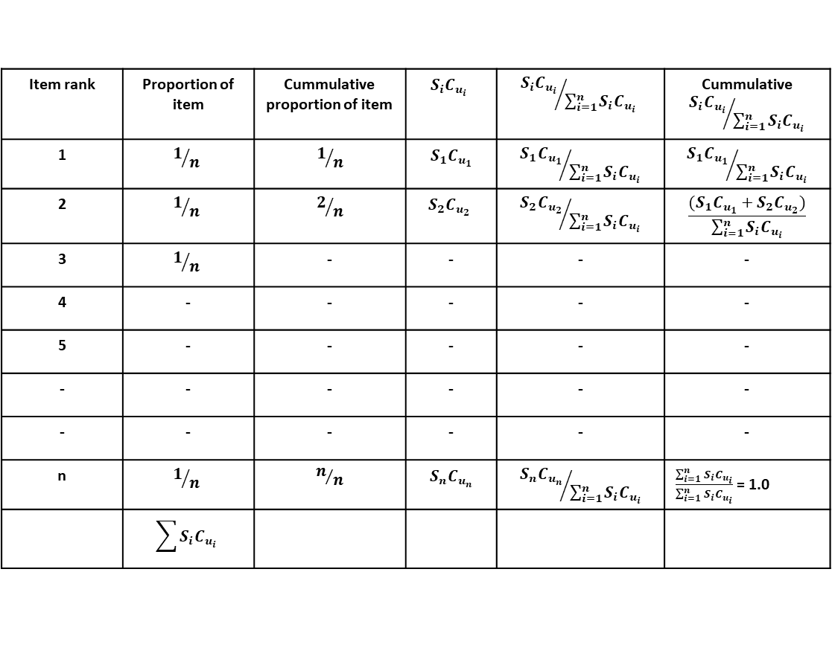
Item rank | Proportion of items | Cummulative proportion of items
1
2
3 |  | - | - | - | -
4 | - | - | - | - | -
5 | - | - | - | - | -
- | - | - | - | - | -
- | - | - | - | - | -
n
PROF PRADIP KUMAR RAY
DEPARTMENT OF INDUSTRIAL AND SYSTEMS ENGINEERING
IIT KHARAGPUR

Slide 24
How to collect data for A-B-C Analysis?
Plot the values of cummulative proportion of annual usage value (Y-axis) against the cummulative proportion of total number of items considered (X-axis).
Decide on proportions of A, B, and C class of items.
In respect of other classification schemes, the importance of an item is defined subjectively with the specific range of values of each category in a classification scheme set by concerned experts or decision makers. The values may be given in nominal scale also.
PROF PRADIP KUMAR RAY
DEPARTMENT OF INDUSTRIAL AND SYSTEMS ENGINEERING
IIT KHARAGPUR

Slide 25
How to collect data for A-B-C Analysis?
The main objective of selective inventory management is to ensure the best-possible return or benefits from an inventory study by improving the inventory control systems and norms of ‘non-trivial’ or important items.
A periodic review of each classification scheme is needed for its usability in a changing demand and price pattern for the inventory items.
PROF PRADIP KUMAR RAY
DEPARTMENT OF INDUSTRIAL AND SYSTEMS ENGINEERING
IIT KHARAGPUR

Slide 26
How to collect data for A-B-C Analysis?
The following points may be noted in respect of this classification scheme:
There is no hard and fast rule in determining the proportion or number of A, B, or C items.
The proportion or number in each category depends on the shape of the A-B-C curve.
The proportion or number of items in each category is decided subjectively following Pareto principle (occurrence of few ‘non-trivial’ (important) items compared to many ‘trivial’ (unimportant) items.
PROF PRADIP KUMAR RAY
DEPARTMENT OF INDUSTRIAL AND SYSTEMS ENGINEERING
IIT KHARAGPUR

Slide 27
How to collect data for A-B-C Analysis?
In a given situation, the existing inventory control systems being used for A class items need to be studied and assessed. If improvement in inventory control is effective, the corresponding savings in inventory cost may be enormous. Assessment of B-class items is the next priority. For C-class items, the existing system may continue.
PROF PRADIP KUMAR RAY
DEPARTMENT OF INDUSTRIAL AND SYSTEMS ENGINEERING
IIT KHARAGPUR

Slide 28
A numerical example of A-B-C Analysis
Perform A-B-C analysis using the following data:
Item | Annual demand (units) | Unit price (Rs) | Item | Annual demand (units) | Unit price (Rs)
1 | 700 | 5.00 | 7 | 6,000 | 8.20
2 | 2,400 | 3.50 | 8 | 300 | 3.50
3 | 150 | 10.00 | 9 | 30 | 8.00
4 | 60 | 22.00 | 10 | 2,900 | 0.40
5 | 3,800 | 1.50 | 11 | 1,150 | 7.50
6 | 4,000 | 0.50 | 12 | 410 | 6.20
PROF PRADIP KUMAR RAY
DEPARTMENT OF INDUSTRIAL AND SYSTEMS ENGINEERING
IIT KHARAGPUR

Slide 29
Determination of usage values:
Item | Annual demand (units) | Unit price (Rs) | Annual usage (Rs) | Percent of total | Rank
1 | 700 | 5.00 | 3,500 | 9.8 | 4
2 | 2,400 | 3.00 | 7,200 | 20.2 | 2
3 | 150 | 10.00 | 1,500 | 4.2 | 7
4 | 60 | 22.00 | 1,320 | 3.7 | 8
5 | 3,800 | 1.50 | 5,700 | 16.0 | 3
6 | 4,000 | 0.50 | 2,000 | 5.6 | 6
7 | 6,000 | 0.20 | 1,200 | 3.4 | 9
PROF PRADIP KUMAR RAY
DEPARTMENT OF INDUSTRIAL AND SYSTEMS ENGINEERING
IIT KHARAGPUR

Slide 30
Determination of usage values:
Item | Annual demand (units) | Unit price (Rs) | Annual usage (Rs) | Percent of total | Rank
8 | 300 | 3.50 | 1,050 | 3.0 | 11
9 | 30 | 8.00 | 240 | 0.7 | 12
10 | 2,900 | 0.40 | 1,160 | 3.3 | 10
11 | 1,150 | 7.10 | 8,165 | 23.0 | 1
12 | 410 | 6.20 | 2,542 | 7.1 | 5
 |  | Total | 35,577 | 100.0
PROF PRADIP KUMAR RAY
DEPARTMENT OF INDUSTRIAL AND SYSTEMS ENGINEERING
IIT KHARAGPUR

Slide 31
Determination of cummulative percentage:
Rank | Item no. | % value | Cum. Value | % of items | Cum. Items
1 | 11 | 23.0 | 23.0 | 8.3 | 8.3
2 | 2 | 20.2 | 43.2 | 8.3 | 16.6
3 | 5 | 16.0 | 59.2 | 8.4 | 25.0
4 | 1 | 9.8 | 69.0 | 8.3 | 33.3
5 | 12 | 7.1 | 76.1 | 8.3 | 41.6
6 | 6 | 5.6 | 81.7 | 8.4 | 50.0
PROF PRADIP KUMAR RAY
DEPARTMENT OF INDUSTRIAL AND SYSTEMS ENGINEERING
IIT KHARAGPUR

Slide 32
Determination of cummulative percentage:
Rank | Item no. | % value | Cum. Value | % of items | Cum. Items
7 | 3 | 4.2 | 85.9 | 8.3 | 58.3
8 | 4 | 3.7 | 89.6 | 8.3 | 66.6
9 | 7 | 3.4 | 93.0 | 8.4 | 75.0
10 | 10 | 3.3 | 96.3 | 8.3 | 83.3
11 | 8 | 3.0 | 99.3 | 8.3 | 91.6
12 | 9 | 0.7 | 100.0 | 8.4 | 100.0
PROF PRADIP KUMAR RAY
DEPARTMENT OF INDUSTRIAL AND SYSTEMS ENGINEERING
IIT KHARAGPUR

Slide 33
A-B-C curve is shown below:
100
90
80
Percent of total annual usage value
50
A
B
C
10
20
30
40
50
60
70
80
90
100
Percent of items
PROF PRADIP KUMAR RAY
DEPARTMENT OF INDUSTRIAL AND SYSTEMS ENGINEERING
IIT KHARAGPUR

Slide 34
Inventory Problems and Selective Inventory Management
Other Types of Classification Schemes and their Use (Part-I)
PROF PRADIP KUMAR RAY
DEPARTMENT OF INDUSTRIAL AND SYSTEMS ENGINEERING
IIT KHARAGPUR

Slide 35
Other Types of Classification Schemes and their Use (Part-1)
In the majority of the organizations, A-B-C classification along with one or two additional classification schemes are used.
Among the other classification schemes, V-E-D and F-S-N schemes are found to be essential in most instances.
PROF PRADIP KUMAR RAY
DEPARTMENT OF INDUSTRIAL AND SYSTEMS ENGINEERING
IIT KHARAGPUR

Slide 36
V-E-D Classification: How to collect data?
V-E-D classification is based on ‘criticality’ of an item.
Inventory items related to operations and maintenance of machineries and processes in a manufacturing or in a service system are classified under V-E-D scheme.
For classification of the items under this scheme, we need to define the level of criticality of each item with respect to its importance to the functional or use value of the machinery or the process of which it is a part.
PROF PRADIP KUMAR RAY
DEPARTMENT OF INDUSTRIAL AND SYSTEMS ENGINEERING
IIT KHARAGPUR

Slide 37
V-E-D Classification: How to collect data?
The items which are vital for the ‘functional value’ or ‘use value’ of the machinery or the process are considered as ‘Vital’ items. There may not be any substitutes for these items.
The items that are considered to have ‘appearance’ or ‘esteem’ value are considered to be ‘Desirable’. There may be one or more than one substitutes for these items.
‘Essential’ items are those for which a few substitutes may be available with additional cost of procurement.
PROF PRADIP KUMAR RAY
DEPARTMENT OF INDUSTRIAL AND SYSTEMS ENGINEERING
IIT KHARAGPUR

Slide 38
V-E-D Classification: How to collect data?
Non-functioning of Vital items may render the machinery or the process useless.
Non-functioning of Essential items may jeopardize the functioning of a portion of the machinery or the process.
For a given list of n number of items, the following data need to be collected:
PROF PRADIP KUMAR RAY
DEPARTMENT OF INDUSTRIAL AND SYSTEMS ENGINEERING
IIT KHARAGPUR

Slide 39
V-E-D Classification: How to collect data?
Select a measurement scale for criticality: you may select a four- or five- point scale (1 – least critical, 2 – slightly critical, 3 – critical, 4 – highly critical, 5 – very highly critical). While you select the criticality scale, you need to define the criticality level against each rating value.
Against each item i, refer to the functional diagram of the machinery or the process where it is a part of.
Assess functional value of item i in terms of its level of criticality.
Prepare a table as follows:
PROF PRADIP KUMAR RAY
DEPARTMENT OF INDUSTRIAL AND SYSTEMS ENGINEERING
IIT KHARAGPUR

Slide 40
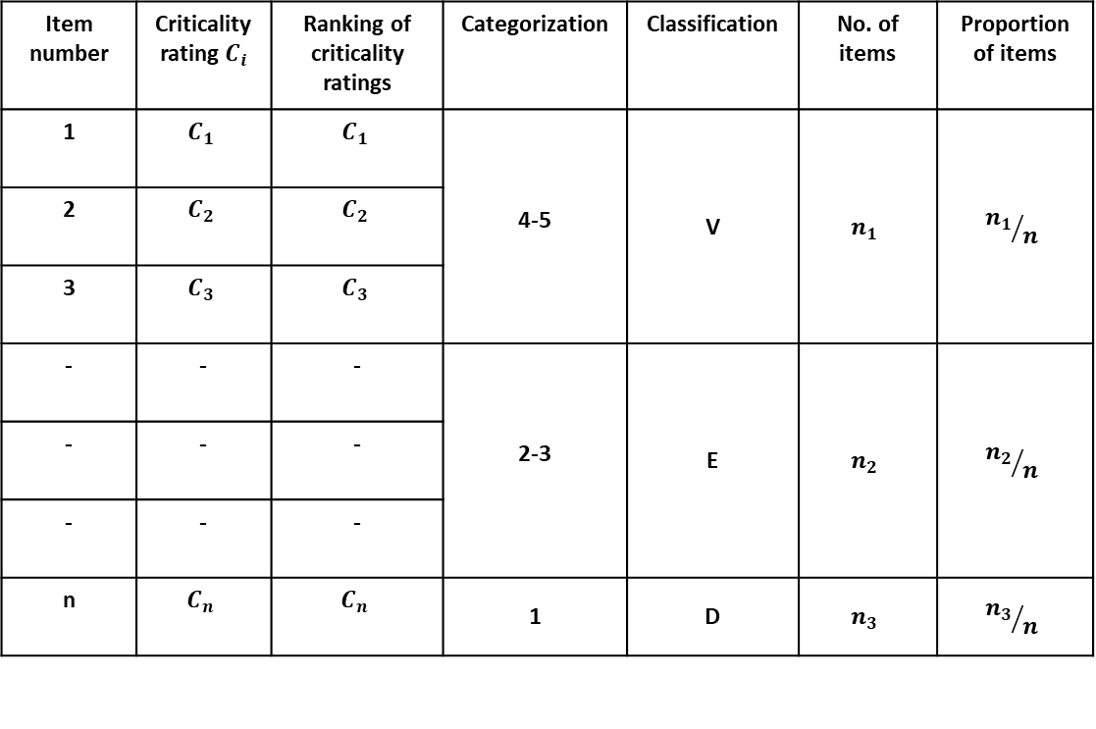
Item number |  | Ranking of criticality ratings | Categorization | Classification | Number of items | Proportion of items
1 |  |  | 4-5 | V
2
3
- | - | - | 2-3 | E
- | - | -
- | - | -
n |  |  | 1 | D
PROF PRADIP KUMAR RAY
DEPARTMENT OF INDUSTRIAL AND SYSTEMS ENGINEERING
IIT KHARAGPUR

Slide 41
V-E-D Classification: How to collect data?
From the above table, we will come to know, for a set of items, the proportion of items in Vital, Essential, and Desirable categories.
In an organization, we need to identify and assess the current inventory control policies and systems related to each category of items.
PROF PRADIP KUMAR RAY
DEPARTMENT OF INDUSTRIAL AND SYSTEMS ENGINEERING
IIT KHARAGPUR

Slide 42
F-S-N Classification: How to collect data?
It is observed in the majority of the organizations that all the inventory items are not used at the same rate. Whereas for certain items that are directly related to produced products in an ongoing and recurring process, the consumption rate may be very high, for other items the consumption rate may be very low due to a number of reasons.
Reasons for low consumption rate are manifold:
Change in product design
Change in production methods
Change in demand levels
Aggressive purchasing
PROF PRADIP KUMAR RAY
DEPARTMENT OF INDUSTRIAL AND SYSTEMS ENGINEERING
IIT KHARAGPUR

Slide 43
F-S-N Classification: How to collect data?
Change in technology
Forecasting errors in estimation of demand
Obsolescence of items
Items with very less consumption rate may become a ‘Deadstock’ occupying physical space with huge amount of capital tied up affecting both operational and financial performance.
It is important that existing inventory policies of slow and non-moving items are to be reviewed periodically so that excess stock is determined on a regular basis and liquidation or disposal alternatives are adopted for increasing the working capital of the organization.
PROF PRADIP KUMAR RAY
DEPARTMENT OF INDUSTRIAL AND SYSTEMS ENGINEERING
IIT KHARAGPUR

Slide 44
F-S-N Classification: How to collect data?
The following steps are to be followed for carrying out F-S-N analysis:
Define and classify consumption rate under three categories: Fast moving, Slow moving, and Non-moving items. For each category, the range of consumption rate is to be specified. The selection of consumption rate and its range in a given category mainly depends on the capacity and the production rate for each item in a given time period with the consideration of allowances for wastage and scrap.
Prepare a table as follows:
PROF PRADIP KUMAR RAY
DEPARTMENT OF INDUSTRIAL AND SYSTEMS ENGINEERING
IIT KHARAGPUR

Slide 45
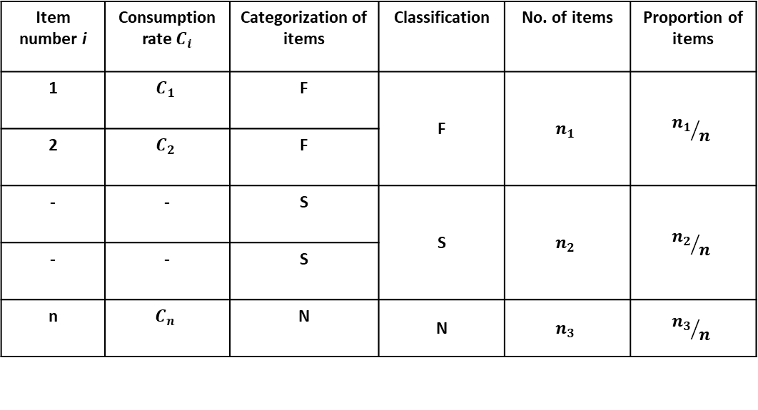
Rules for categorization: Fast moving: $R_{1}$ and above, Slow moving:${ R}_{2}$ to $R_{1}$, Non-moving: below ${ R}_{2}$
Item, i |  | Categorization of items | Classification (as per rules given) | Number of items | Proportion of items
1 |  | F | F
2 |  | F
- | - | S | S
- | - | S
n |  | N | N
PROF PRADIP KUMAR RAY
DEPARTMENT OF INDUSTRIAL AND SYSTEMS ENGINEERING
IIT KHARAGPUR

Slide 46
F-S-N Classification: How to collect data?
When A-B-C, V-E-D, and F-S-N classification are simultaneously used for all the inventory items, we have altogether 3×3×3 = 27 combinations. These combinations are represented in the Figure below:
PROF PRADIP KUMAR RAY
DEPARTMENT OF INDUSTRIAL AND SYSTEMS ENGINEERING
IIT KHARAGPUR

Slide 47
N
S
D
E
F
V
A
B
C
PROF PRADIP KUMAR RAY
DEPARTMENT OF INDUSTRIAL AND SYSTEMS ENGINEERING
IIT KHARAGPUR

Slide 48
F-S-N Classification: How to collect data?
Combinations involving A & B, V & E, and F & S may be categorized as very important. Existing inventory policies for these items are to be regularly assessed and improved.
For items in remaining combinations, the existing inventory control policies may continue.
PROF PRADIP KUMAR RAY
DEPARTMENT OF INDUSTRIAL AND SYSTEMS ENGINEERING
IIT KHARAGPUR

Slide 49
Inventory Problems and Selective Inventory Management
S-D-E Analysis: Basic Characteristics, Issues and Advantages
X-Y-Z Analysis: Basic Characteristics, Issues and Advantages
Key points to remember
PROF PRADIP KUMAR RAY
DEPARTMENT OF INDUSTRIAL AND SYSTEMS ENGINEERING
IIT KHARAGPUR

Slide 50
S-D-E Analysis: Basic Characteristics, Issues and Advantages
S-D-E Analysis:
In S-D-E analysis, the classification is based on an inventory item’s importance in respect of its availability.
As inventory of an item, direct or indirect, is needed as and when required and there must be continuity of supply of the items to a production system, availability is considered an important aspect.
PROF PRADIP KUMAR RAY
DEPARTMENT OF INDUSTRIAL AND SYSTEMS ENGINEERING
IIT KHARAGPUR

Slide 51
S-D-E Analysis: Basic Characteristics, Issues and Advantages
Non-availability means no stock and hence, understock or out-of-stock situation and corresponding effect of disruption in production system or in maintenance/service activities of an organization.
For carrying out S-D-E analysis, we used to define first each category.
PROF PRADIP KUMAR RAY
DEPARTMENT OF INDUSTRIAL AND SYSTEMS ENGINEERING
IIT KHARAGPUR

Slide 52
S-D-E Analysis: Basic Characteristics, Issues and Advantages
For carrying out S-D-E analysis, we need to define first each category:
S (Scarce): These items are considered scarce, mostly imported from another country, like raw materials, or important parts/components which a foreign company can only supply. Without these components, products can not be produced. These items may be very expensive.
PROF PRADIP KUMAR RAY
DEPARTMENT OF INDUSTRIAL AND SYSTEMS ENGINEERING
IIT KHARAGPUR

Slide 53
S-D-E Analysis: Basic Characteristics, Issues and Advantages
D (Difficult to Procure): These items are considered ‘difficult to procure’ in the sense that even if they are not imported, they are to be procured from a source located in another region of the country and/or for procurement of such items special rules and regulations need to be complied with for which a cumbersome procedure is to be followed.
E (Easy to Procure): These items are considered ‘easy to procure’ in the sense that they can be procured from local markets, mostly those items for which a number of sources are available and simple purchase procedure like blanket order or yearly order system may be preferred.
PROF PRADIP KUMAR RAY
DEPARTMENT OF INDUSTRIAL AND SYSTEMS ENGINEERING
IIT KHARAGPUR

Slide 54
S-D-E Analysis: Basic Characteristics, Issues and Advantages
Once the items are classified as per above stated norms, the total number of items in each category is known.
For a standard or fixed product mix, this analysis may be carried out once a year, and the change in the number of items of each category depends on a number of factors like flexibility in process plan, change in supplier base, change in purchasing policy, etc.
For a frequently changing product mix, this analysis needs to be carried out at least twice a year.
PROF PRADIP KUMAR RAY
DEPARTMENT OF INDUSTRIAL AND SYSTEMS ENGINEERING
IIT KHARAGPUR

Slide 55
S-D-E Analysis: Basic Characteristics, Issues and Advantages
The purchasing system or procedure being followed for S and D items are to be made as simple as possible to streamline the purchase process with minimum number of control points and minimum lead time.
Usually the S and D items are procured in quantities sufficient to meet yearly demand with its fluctuations considered.
S-D-E analysis is a priority if the proportion of items in ‘Bill of Materials’ or BOM that are to be purchased from inside is very high (say 70-80%) and the manufacturing strategy is ‘manufacture-to-order’ or ‘assemble-to-order’.
PROF PRADIP KUMAR RAY
DEPARTMENT OF INDUSTRIAL AND SYSTEMS ENGINEERING
IIT KHARAGPUR

Slide 56
S-D-E Analysis: Basic Characteristics, Issues and Advantages
If the number of E items is substantial, computer-to-computer purchase system can be initiated with significant positive control on inventory and lead time.
The main advantages of S-D-E analysis are as follows:
Minimum shortages in scarce items ensuring control on manufacturing cycle and throughput time.
PROF PRADIP KUMAR RAY
DEPARTMENT OF INDUSTRIAL AND SYSTEMS ENGINEERING
IIT KHARAGPUR

Slide 57
S-D-E Analysis: Basic Characteristics, Issues and Advantages
Adequate control on inventory investment if imported goods/items are needed in large quantity and expensive.
Efficient purchase management system with a strong import-export cell playing an important role in materials substitution.
Development of alternative process plan with the minimum number of imported components is a possibility.
PROF PRADIP KUMAR RAY
DEPARTMENT OF INDUSTRIAL AND SYSTEMS ENGINEERING
IIT KHARAGPUR

Slide 58
X-Y-Z Analysis: Basic Characteristics, Issues and Advantages
In X-Y-Z analysis, the classification is based on an inventory item’s importance in terms of its average inventory during a period of time, usually in a month or a year.
The result of the analysis is indicative of to what extent the objective of minimum inventory investment is achieved for an item.
In respect of arrange inventory investment, the items are categorized as X, Y, and Z items.
PROF PRADIP KUMAR RAY
DEPARTMENT OF INDUSTRIAL AND SYSTEMS ENGINEERING
IIT KHARAGPUR

Slide 59
X-Y-Z Analysis: Basic Characteristics, Issues and Advantages
We define each category of items as follows:
X items: These items with ‘very high’ average inventory level are considered an important problem and it is essential that appropriate and adequate improvement measures are to be taken for reducing the inventory level. For such items, excess stock determination is a must.
Y items: These items with high inventory level are considered less important and it is natural to take preventive and corrective measures for inventory level reduction.
PROF PRADIP KUMAR RAY
DEPARTMENT OF INDUSTRIAL AND SYSTEMS ENGINEERING
IIT KHARAGPUR

Slide 60
X-Y-Z Analysis: Basic Characteristics, Issues and Advantages
Z items: These items with adequate inventory level are not considered critical and the procedure being used and adopted needs to be continued.
Once the items are classified as per above stated norms, the total number of items in each category is known. The number in each category is determined by subjective judgement.
PROF PRADIP KUMAR RAY
DEPARTMENT OF INDUSTRIAL AND SYSTEMS ENGINEERING
IIT KHARAGPUR

Slide 61
X-Y-Z Analysis: Basic Characteristics, Issues and Advantages
The reasons of high inventory levels for both X and Y items are manifold. In a highly dynamic business environment, the possible reasons are as follows:
Redesign of product
Change in production methods
Reduction in product demand
PROF PRADIP KUMAR RAY
DEPARTMENT OF INDUSTRIAL AND SYSTEMS ENGINEERING
IIT KHARAGPUR

Slide 62
X-Y-Z Analysis: Basic Characteristics, Issues and Advantages
New technological innovation
Forecast errors
Excess purchase of items
Record keeping errors
Introduction of new products
PROF PRADIP KUMAR RAY
DEPARTMENT OF INDUSTRIAL AND SYSTEMS ENGINEERING
IIT KHARAGPUR

Slide 63
X-Y-Z Analysis: Basic Characteristics, Issues and Advantages
The excess stock in respect of X and Y items need to be determined following specific/standard procedure with its implementation with management information system support.
Any amount in stock greater than order quantity and safety stock is considered excess.
Excess stock problems can be addressed by using a number of liquidation alternatives:
PROF PRADIP KUMAR RAY
DEPARTMENT OF INDUSTRIAL AND SYSTEMS ENGINEERING
IIT KHARAGPUR

Slide 64
X-Y-Z Analysis: Basic Characteristics, Issues and Advantages
Circulation within the company
Returning to the suppliers
Direct sales to other firms
Sales to the employees, or sale or auction to the public
PROF PRADIP KUMAR RAY
DEPARTMENT OF INDUSTRIAL AND SYSTEMS ENGINEERING
IIT KHARAGPUR

Slide 65
X-Y-Z Analysis: Basic Characteristics, Issues and Advantages
The analysis is essential for proper inventory management and must be done as a priority by management.
Main advantage in running inventory and production/service control system of an organization with adequate and minimum inventory investment.
Total cost of production in the long run is significantly reduced.
PROF PRADIP KUMAR RAY
DEPARTMENT OF INDUSTRIAL AND SYSTEMS ENGINEERING
IIT KHARAGPUR

Slide 66
Key points to remember
In A-B-C and all other classification schemes, the inventory items are classified into three categories on the basis of their ‘important’ characterization.
Items in each category are required to be identified, their inventory control systems to be known, and evaluated with respect to a number of performance measures.
PROF PRADIP KUMAR RAY
DEPARTMENT OF INDUSTRIAL AND SYSTEMS ENGINEERING
IIT KHARAGPUR

Slide 67
Key points to remember
The ‘border-line’ inventory items in any classification scheme are to be identified, and specific rules to be prescribed for their categorization.
Both objective and subjective analyses are recommended for prescribing classification schemes.
PROF PRADIP KUMAR RAY
DEPARTMENT OF INDUSTRIAL AND SYSTEMS ENGINEERING
IIT KHARAGPUR

Slide 68
List of Reference Textbooks
Starr, M K and Miller, D W, Inventory Control: Theory and Practice, Prentice Hall.
Tersine, R J, Principles of Inventory and Materials Management, PTR Prentice Hall.
Silver, E A, Pyke, D F and Peterson, R, Inventory Management and Production Planning and Scheduling, John Wiley.
Prof Pradip Kumar Ray
Department of Industrial and Systems Engineering

Slide 69
Thank You!!

